Slide 1
First steps in research data management for life scientists
Denise Dörfel, Robert Müller
Service Center Research Data (Kontaktstelle Forschungsdaten)
A brief overview
Talk
CMCB/PoL Campus Workshop, 27.05.2024

Slide 2
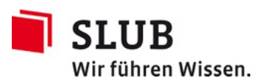


The Service Center Research Data
Team:
4 consultants
2 IT specialists
Services:
PLAN – Data management plan (DMP)
INFORM – Consultation and information on RDM
IMPLEMENT – Support with RDM
Cooperation between
Department 4.3 Research-related Services
Center for Interdisciplinary Digital Sciences (CIDS) Department Information Services and High Performance Computing (ZIH)
Website: https://tu-dresden.de/kontaktstelle-forschungsdaten
E-Mail: kontaktstelle-forschungsdaten@tu-dresden.de
Certified in ITIL and Requirements Engineering

Slide 3
Research data management - definition
Management
Planning and organization
actions
in compliance with
goal-oriented principles
=
of
Management of research data
Planning and organization
research practices
in compliance with
good scientific practice
=
of
Notes:
Through planning and organization, RDM creates awareness of the necessary research practices to integrate the elements of good scientific practice into day-to-day research

Slide 4


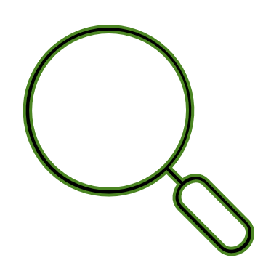
Key elements of good scientific practice
The GSP guidelines aim to ensure that researchers and their institutions ...
consider the current state of the art of science and know the scientific environment.
take responsibility.
ensure the verifiability of the research.
Knowledge
Responsibility
Verifiability

Slide 5



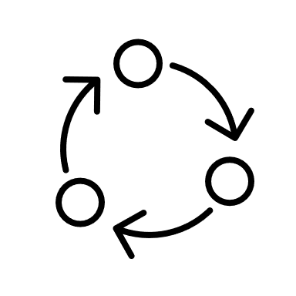
RDM helps with good scientific practice – How?
What is to be achieved with research data management?
Data are useful, secure, complete, comprehensible, standardized.
The context is preserved and the quality is increased.
The reuse is facilitated – for yourself, the project group, the chair or the community.
Findable
Accessible
Interoperable
Reusable

Slide 6
First steps
Best practices to begin with

Slide 7


What are my research data? The life cycle of research data
Data collection planned
Data created / collected
Data processed
Data analyzed
Data shared / published
Data archived
Data reused
Time points can serve as triggers for specific actions by certain people
The sequence of actions should be recorded, e.g. as a checklist
Nach: https://forschungsdaten.info/themen/informieren-und-planen/datenlebenszyklus/
Timing
Checklist
Notes:
Definition of research data (TUD):
“All data that is collected, observed, derived, simulated or otherwise generated in connection with research. Research data occurs in different forms and formats in each scientific discipline.“
+ 2 – 3 examples from the life sciences: miscroscope images, sequencing data, scripts for bioinformatical analyses
Examples for sensible moments:
An experimental series / survey has been finished.
An article, conference paper or thesis has been finished.
A project (or a project phase) starts or ends.
Example: Acceptance of a conference paper
Move the manuscript to the shared network drive.
Check the associated data for integrity and completeness and store them on the shared network drive as well.
Enrich the data with documentation and add necessary protocols / scripts.
Archive the dataset together with the manuscript on OPARA.

Slide 8
Where could the data be stored?
What requirements do you place on the storage system?
 | Suitable | Not suitable
Do others need to have access? | Group drive, Datashare | Your PC, Home drive
Do I have to store TB of data? | Group drive, OPARA | Home drive, Datashare
Should external users have access without a guest login? | Datashare | Group drive, SharePoint
Is a backup necessary? | Group drive, Home drive | Datashare
Do I have to store sensitive data? | Group drive, SharePoint | Your PC, Datashare

Slide 9
Where could the data be stored?
What requirements do you place on the storage system?
 | Suitable | Not suitable
Do others need to have access? | Group drive, Datashare | Your PC, Home drive
Do I have to store TB of data? | Group drive, OPARA | Home drive, Datashare
Should external users have access without a guest login? | Datashare | Group drive, SharePoint
Is a backup necessary? | Group drive, Home drive | Datashare
Do I have to store sensitive data? | Group drive, SharePoint | Your PC, Datashare

Slide 10

How to create a (shared) folder structure
Upper level of the folder structure: Which terms are known and understood by all? Pick one approach.
Lower levels of the folder structure: Each subfolder is given a structuring approach that you understand, know and (can) follow.
by "purpose“
Why is data collected?
by "degree of processing“
How much data was processed?
by „chronology“
How are data classified in terms of time?
by „origin“
What is the origin of data?
Use as subfolder
Use as subfolder
Use as subfolder
Use as subfolder
Working package
Raw data
ID-System
Device
Study
Processed data
Test series
Person
Task
Results
Measuring time
Simulation
Notes:
Life sciences:
Degree of processing: e.g. microscope images with several rounds of processing
Origin: e.g. multiple microscopes or sequencing machines

Slide 11

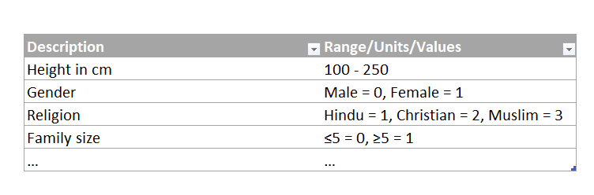
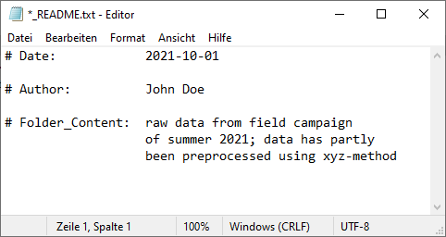
Data documentation and metadata
Metadata
Metadata are data about data – What information about your data is required?
Use existing metadata standards or develop a custom standard for your research.
Think of how and where you want to store the metadata and further documentation – ReadMe files, codebooks, …
Data
Generic: e.g. Dublin Core
Discipline-specific: e.g. REMBI, ISA
Notes:
Metadaten: Ihr Zweck ist das zugehörige Datenobjekt zu definieren und zu beschreiben; es existieren verschiedenen Arten (administrativ, strukturell, deskriptiv).
REMBI (Recommended Metadata for Biological Images): information on study, sample, specimen, image acquisition / data / correlation, analysis; uses other standards for the different aspects
ISA (Investigation/Study/Assay): general purpose framework with which to collect and communicate complex metadata (i.e. sample characteristics, technologies used, type of measurements made) from 'omics-based' experiments employing a combination of technologies

Slide 12
How to achieve high data quality?
Preserve knowledge (protocols, scripts, lab notebook, …)!
Perform data cleanup regularly!
Use peer review for data quality management!
Introduce/use standards in the lab/team (checklists, guidelines, lab manual, …)!
Assign responsibilities and create resources, if possible!
People
Skills and competences
Time
Money

Slide 13
Summary – What could your first steps look like?
Work on the following questions:
What are my research data?
Which moments and steps are important for my RDM?
Where do I store my research data?
How do I structure my data storage?
What documentation is necessary?
Answer these questions according to your research practices.

Slide 14
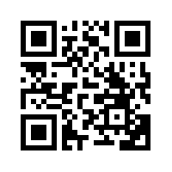
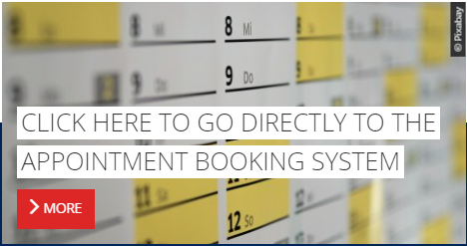
Our Services and next Steps
PLAN – Data management plan (DMP)
Text modules for individual project proposals
DMP concept for collaborative project proposals
Review of DMP drafts
INFORM – Consultation and information on RDM
Inquiries and information
Consultation meetings
Talks and lectures
IMPLEMENT – Support with RDM
Implementation assistance with RDM projects
Research data offboarding
Technical support
Look for further lectures of the Service Center Research Data or book an appointment.

Slide 15
Thank you for your attention
Service Center Research Data
https://tu-dresden.de/kontaktstelle-forschungsdaten
kontaktstelle-forschungsdaten@tu-dresden.de

